Slide 1

SOFTWARE TESTING
UE18CS400SB
Prof. Venkatesh Prasad
venkateshprasad@pes.edu
Department of Computer Science

Slide 2

SOFTWARE TESTING
Non-Functional Testing

Slide 3
SOFTWARE TESTING
Overview
Functional Testing
To evaluate the functional requirements of a system and focus on the outputs generated in response to selected inputs and execution conditions
Focus is on testing the product’s behavior (both positive & negative) from a direct output point of view

Slide 4
SOFTWARE TESTING
Overview
Non-Functional testing
Testing the abilities of the system.
Reliability
Scalability
Performance
Stress
Interoperability
Compatibility
Security

Slide 5
SOFTWARE TESTING
Why Non-Functional Testing?
To find design faults and to help in fixing them.
To find the limits of the product
▪ Max no. of concurrent access, min memory, max # of rows
To find out whether the product can behave gracefully during stress and load conditions
To ensure that the product can work without degrading for a long duration
To compare with other products and previous version of the product under test.
To avoid un-intended side effects.

Slide 6
SOFTWARE TESTING
Functional vs. Non functional Testing
# | Testing Aspect | Functional Testing | Non functional Testing
1 | Involves | Product features and functionality | Quality factors
2 | Tests | Product behaviour | Behaviour and experience
3 | Result conclusion | Simple steps written to check expected results | Huge data collected and analyzed
4 | Results vary due to | Product implementation | Product implementation, resources and configurations
5 | Testing focus | Defect detection | Qualification of product
6 | Knowledge required | Product and domain | Product and domain, design, architecture and statistical skills (Think Why )
7 | Failures normally due to | Code | Architecture, design and code
8 | Testing phase | Unit, component, integration and system | System
9 | Test case Repeatability | Repeated many times | Repeated only in case of failures and for different configurations
10 | Configuration | One-time set up for a set of test cases | Configuration changes for each test case
Statistical Testing makes use of statistical methods to determine the reliability of the program. See Notes below.
Notes:
Testers handle data on a day-to-day basis, and obviously data alone doesn’t mean anything. It is important to have base data, but the tester wearing the statistician’s hat has to draw meaningful inferences from such data in communicating his/her interpretations to the rest of the product team.
Test Managers have to draw inferences about product quality, predict outcomes based on the current status of defects and test results, and make important product decisions around the release.
Leverage statistical methods to make testing more meaningful in a software development lifecycle. This can mean using statistics to project what past correlations will mean for future test cases.
Additional Ref: https://www.nap.edu/read/9655/chapter/4

Slide 7
SOFTWARE TESTING
Non-Functional Testing
Scalability test
Testing that requires to find out the maximum capability of the product parameters.
Performance test
Testing conducted to evaluate the time taken or response time of the product to perform it's required functions under stated conditions in comparison with different versions of same product and competitive products.

Slide 8
SOFTWARE TESTING
Non-Functional Testing
Reliability test
Testing conducted to evaluate the ability of the product to perform it's required functions under stated conditions for a specified period of time or number of iterations.
Stress test
Testing conducted to evaluate a system beyond the limits of the specified requirements or environment resources (such as disk space, memory, processor utilization, network congestion) to ensure the product behavior is acceptable.

Slide 9
SOFTWARE TESTING
Non-Functional Test Planning
When to start execution
Product does not have basic issues
Meets the minimum criteria
When to end execution
Test results sufficient to make analysis / judgement
Align to product release schedule

Slide 10
SOFTWARE TESTING
Non-Functional Test Planning
Entry/Exit Criteria - Examples
 | Test Parameters | Entry Criteria | Exit Criteria
Scalability Test | Limits | Product should scale up to 1 million records | Product should scale up to 10 million records
Performance Test | Response Throughput | query for 1000 records should be less than 3secs | query for 10000 records should be less than 3secs
Reliability Test | Failures / Iterations Failures / Test Duration | There should be less than 2% failures when queries are run on 1000 records for 24hrs | There should be less that 0.1% failures when queries are run on 1000 records for 48hrs
Stress Test | system when stressed beyond the limits | Product should be able to withstand when 25 clients logins happen simultaneously for 5 hrs | Product should be able to withstand when 100 clients logins happen simultaneously for 5 hrs

Slide 11
SOFTWARE TESTING
Scalability
Ability of a system to handle increasing amounts of work without unacceptable level of performance (degradation)
Vertical scalability (Scale Up)
Add resources to single node (e.g. CPU, memory)
Horizontal scalability (Scale Out)
Add more nodes (e.g. computers, ATMs)
▪ e.g., server cluster
Trade-offs
Mgmt complex, programming /deployment complexity, network latency

Slide 12
▪ The test cases will focus on to test the maximum limits of the features, utilities and performing some basic operations
SOFTWARE TESTING
Scalability Test Design
▪ Few Examples:
▪ Backup and records.
restore of a DB with 1 GB
Add records to until the DB size grows beyond 2 GB.
Repair a DB of 2 million records.

Slide 13
▪ Based on a number of tests, documenting data and analysis
SOFTWARE TESTING
Scalability Test Outcomes
Scalability increases N% for m times the resources – 50% increase if memory is doubled
Suitable, optimal configuration settings for a required scalability settings
This is an important part of application “sizing”
If required scalability not achieved, analysis and remediation done and retested.

Slide 14
SOFTWARE TESTING
Reliability
Probability of failure-free software operation for a specified period of time OR number of operations in a specified environment
Reliable s/w development is difficult
Large s/w continue years of operation
Why?
to have bugs even after 10-20
Testing all paths is “Impossible”
New ways of program failures – Ex, security breach

Slide 15
SOFTWARE TESTING
Test Design – Reliability Testing
The test cases will focus on the product failures when the operations are executed continuously for a given duration or iterations – Long and many!
Examples:
Query for entries which are not available on a particular server, but available on the server which it is referring to continuously for 48 hrs
Run logins from multiple clients for all the available users in the DB for 24 hours.
Focus is more on frequently used operations

Slide 16
# of failures in a given run
Interval of defect free operation - MTBF
SOFTWARE TESTING
Reliability Test Outcomes
Configuration parameter sensitivity – Which parameter causes more unreliability?
Identifying causes of failures is hardest.
Possible Failures reasons?
Memory leaks
Deep defects due to un-initialized values
Weak error handling
Unstable environment
Unintended “side effects”

Slide 17
SOFTWARE TESTING
Stress Testing
To test the behavior of the system under very severe conditions – high load / low resource
Good system should show a graceful degradation in output and safe/acceptable behavior under extremes
Example:
▪ Performing login, query, add, repair, backup etc operations randomly from 50 clients simultaneously at half the rated resource levels – say half memory / low speed processor…
Since stressed conditions are randomly applied over a period of time, this is similar to reliability tests

Slide 18
▪ Run the application with very high load
SOFTWARE TESTING
Stress Testing - Techniques
Run the app with very low resource levels
Run multiple concurrent sessions
Vary the loads/ resources randomly
Tools to
create artificial scarcity of resources
Create artificial high loads

Slide 19
▪ As the resource / load ratio decreases, performance should go down gradually.
SOFTWARE TESTING
Stress Test Outcomes
In extreme conditions, should stop / pause gracefully
Should recover symmetrically when stress conditions ease.

Slide 20
▪ System hang permanently.
SOFTWARE TESTING
Stress Testing - Failure cases
Runtime crash – unexpected
Affect other programs in the system badly or worst the full system is made unstable.
Once stress limit reached, does not recover
when stress levels are reduced

Slide 21
SOFTWARE TESTING
Performance Testing
Performance testing is in general, a testing practice performed to determine how a system performs in terms of responsiveness and stability under a particular workload.
Why Performance testing?
To measure and improve the product performance
To gauge performance against the competing or standard products
To generate data for “product sizing” / capacity planning and product positioning in the market place

Slide 22
SOFTWARE TESTING
Performance Testing
The test cases would focus on getting response time and throughput for different operations, under defined environment and load
Tracking resource consumption when resources are shared with other systems
Example:
Performance for adding 1million records
Benchmarking with the competitor’s product, using some standard benchmarking tools
All under controlled environments

Slide 23
SOFTWARE TESTING
Performance Testing Methodology
Establish the performance requirements
Design the performance test cases
Automate
Conduct testing and collect results
Analyze results
Tune performance
Benchmark
Establish needed configuration size.

Slide 24
SOFTWARE TESTING
Security Testing
Both static and dynamic
Weak spots are called security vulnerabilities
Many test tools to identify vulnerabilities at application level.
Ex.,
Access control – application level
Direct usage of resources through low level code
SQL injection through input
Buffer overflow
Usage of encryption
Sensitive info in non-secure channel(http)
API Interfaces
SQL Injection Reference

Slide 25
▪ Regression testing is a black box testing technique.
SOFTWARE TESTING
Regression Testing
It is used to authenticate a code change in the software does not impact the existing functionality of the product.
Regression testing is making sure that the product works fine with new functionality, bug fixes, or any change in the existing feature.

Slide 26
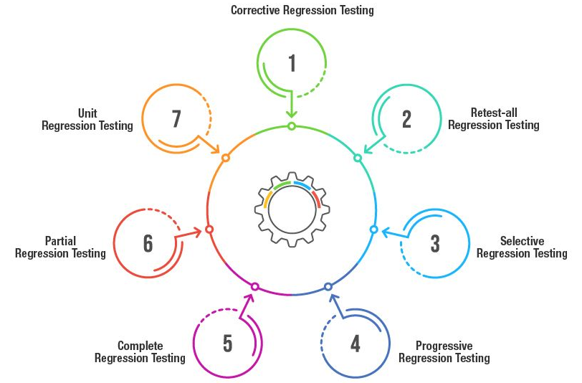
SOFTWARE TESTING
Types of Regression Testing

Slide 27
SOFTWARE TESTING
Types of Regression Testing (Cont.)
Corrective Regression testing
Used when there are no changes made to the product’s specification.
Can reuse existing test cases to make this type of regression testing easier and ultimately arrive at the desired result.
Retest -all Regression testing
Tedious form of regression testing - involves testing all the existing aspects of any particular product along with reusing all the test cases.
This type of testing is not advisable when there is a minor change that has been infused in the existing product.

Slide 28
SOFTWARE TESTING
Types of Regression Testing (Cont.)
Selective Regression testing
Analyzes the impact of new code on the existing code
Uses a subset of existing test cases to reduce the cost and effort needed for retesting
Progressive Regression testing
When there are new test cases and changes in program specifications
Ensures that a new or updated version of your software does not compromise your already existing features

Slide 29
SOFTWARE TESTING
Types of Regression Testing (Cont.)
Complete Regression testing
This is the best regression testing to be used in case of major changes cropping up in your test code.
This is specifically used when there is a major change in the root code of the software.
This is helpful in combating unexpected issues, test before handing off the application to the user.
Partial Regression testing
Tests issues when new code is added to already existing code
Ensures that a system continues to work after adding new code

Slide 30
SOFTWARE TESTING
Types of Regression Testing (Cont.)
Unit Regression testing
Most important part of unit testing
Focuses on the code as a unit, while blocking all associated dependencies & interactions during testing

Slide 31

THANK YOU
Prof. Venkatesh Prasad
venkateshprasad@pes.edu
Department of Computer Science

